Slide 1
Lab 1 -
Music taste prediction
Kuan Teh Wan

Slide 2
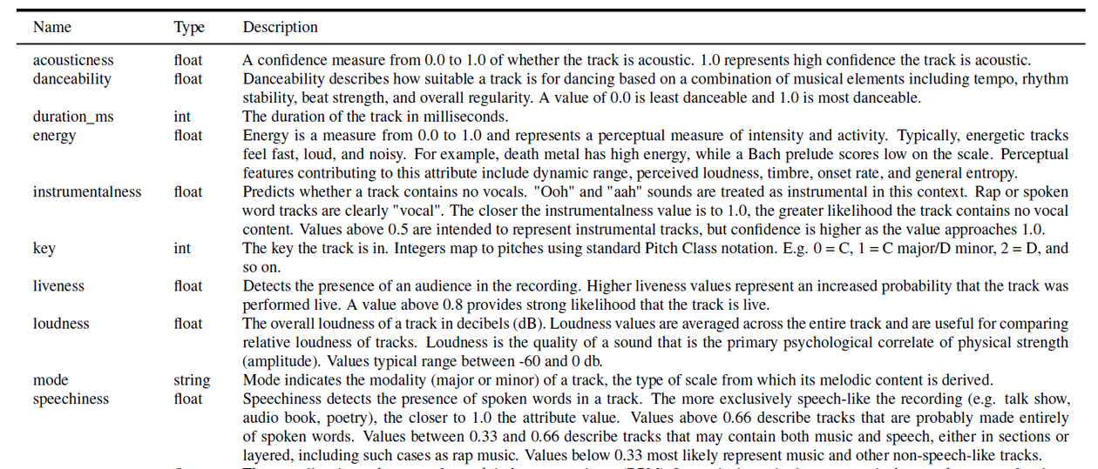
After multiple testings, found out that more doesn’t always mean better. Thus I chose 4 features: acousticness, danceability, duration, speechiness.
And consider them all to be quantitative.

Slide 3
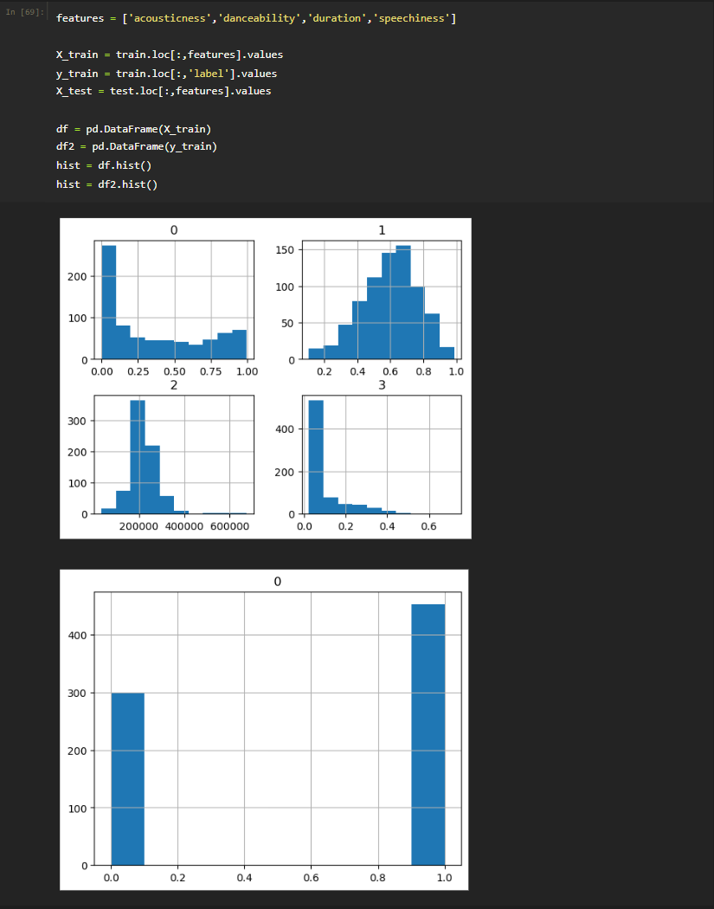
Motivations of
Features(Updated)
  By comparing the histograms of the four features and the label.
  We can see that it’s fairly distributed.
  Hence these features might and can be a good choice for predicting the outcome.

Slide 4
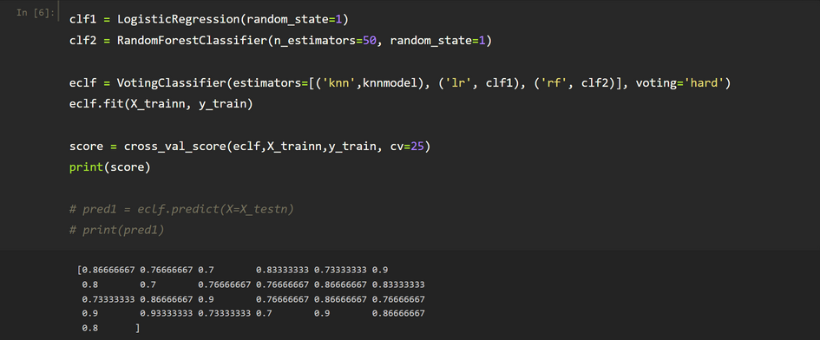
Using
Random Forest
  Random Forests are not influenced by outliers to a fair degree.
  can handle linear & non-linear relationships well.
  Provide high accuracy and balance the bias-variance trade-off well.
Noticed that the highest score can go 0.9, whereas the lowest is 0.7, high accuracy indeed.

Slide 5
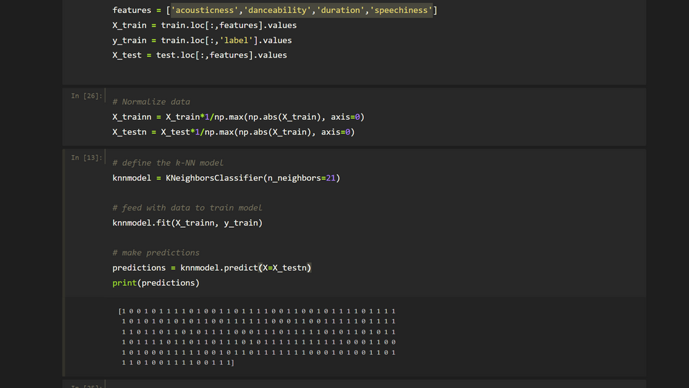
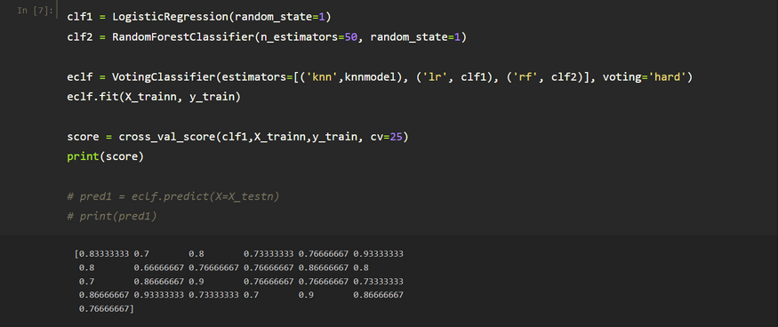
Using
Logistic Regression
Normalize the inputs, and test performance by using cross validation.
  Easy to implement, and efficient to train.
  Fast at classifying unknown data.
  Can extend to multiple classes and a natural probabilistic view of class predictions.

Slide 6
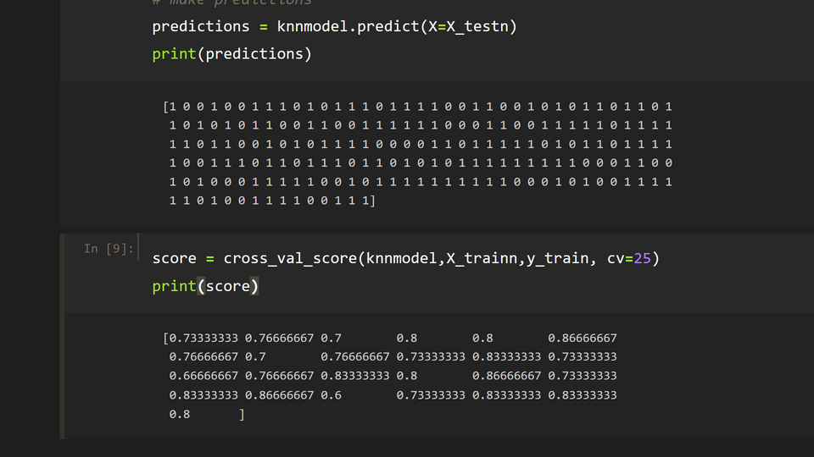
Using KNN
  It’s a non-parametric approach, thus no assumptions on the boundary works well when boundary highly non-linear.
Normalize the inputs, and chooses higher K value (K>20) to avoid overfitting and gives smoother behavior.
Can see that it gives higher score , when using cross-validation to check for performance.

Slide 7
Using
Voting Classifier
  Combine the strengths of multiple models and reduce the impact of individual weaknesses.
  Improve accuracy by using different models.
  Won’t be easily affected to changes, since errors can be cancelled out by other models.
To conclude, to me, the best way is to use voting classifier to combine strength of multiple models, and choose the suitable models according to demand and the data situation.

Slide 8
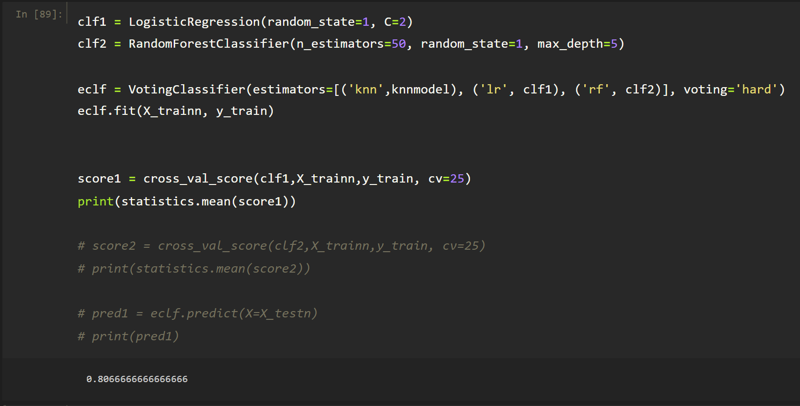
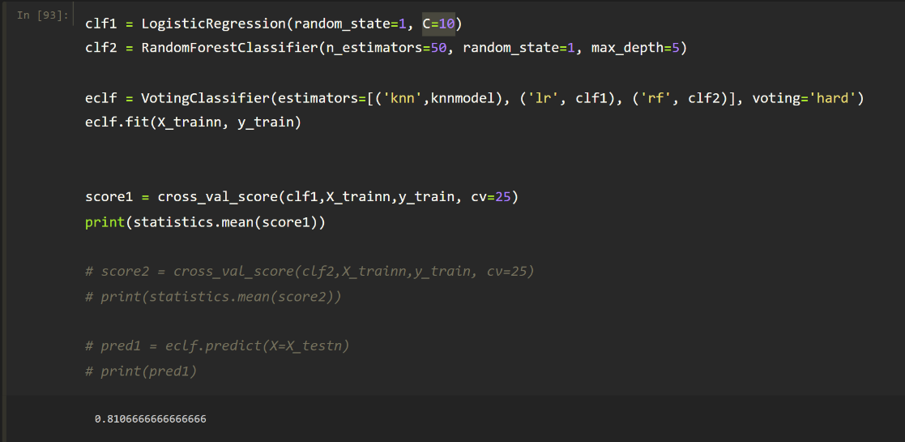
Motivation of Parameters(Updated)
  By tweaking the C parameter, the Inverse of regularization strength(2→10) in Logistic regression we see a rise in cross-validation from (0.80666→0.81666).

Slide 9
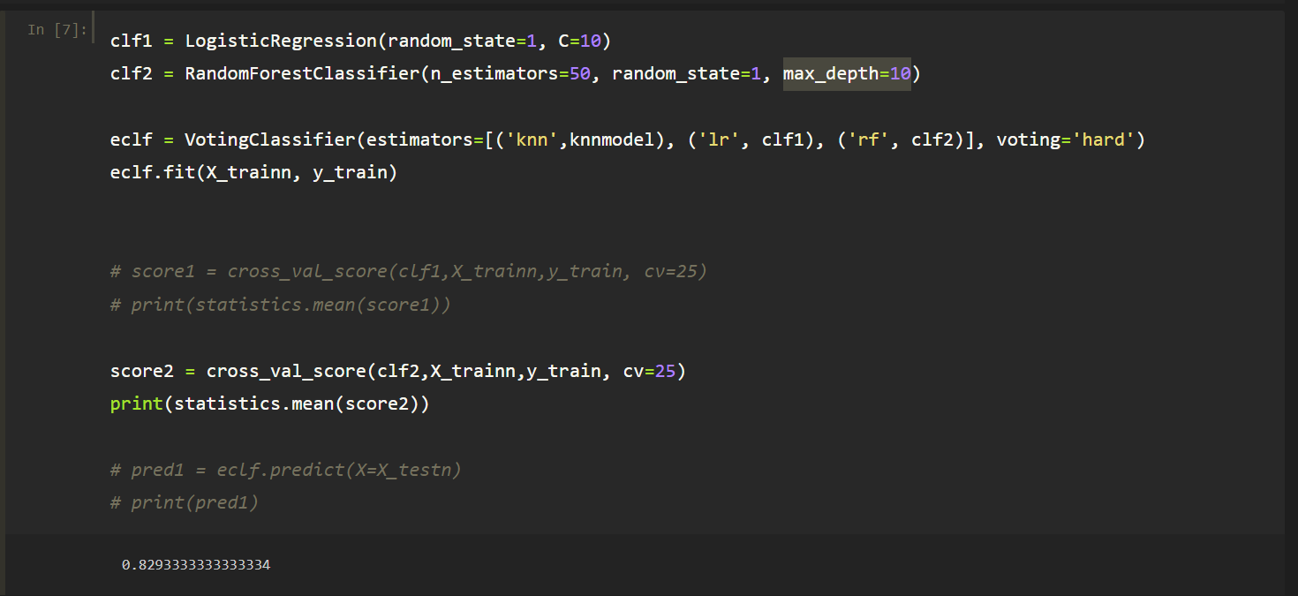

Motivation of Parameters(Updated)
  By tweaking the max_depth parameter(10→5) in Random Forest we see a rise in cross-validation from (0.82933→0.83333).

Slide 10
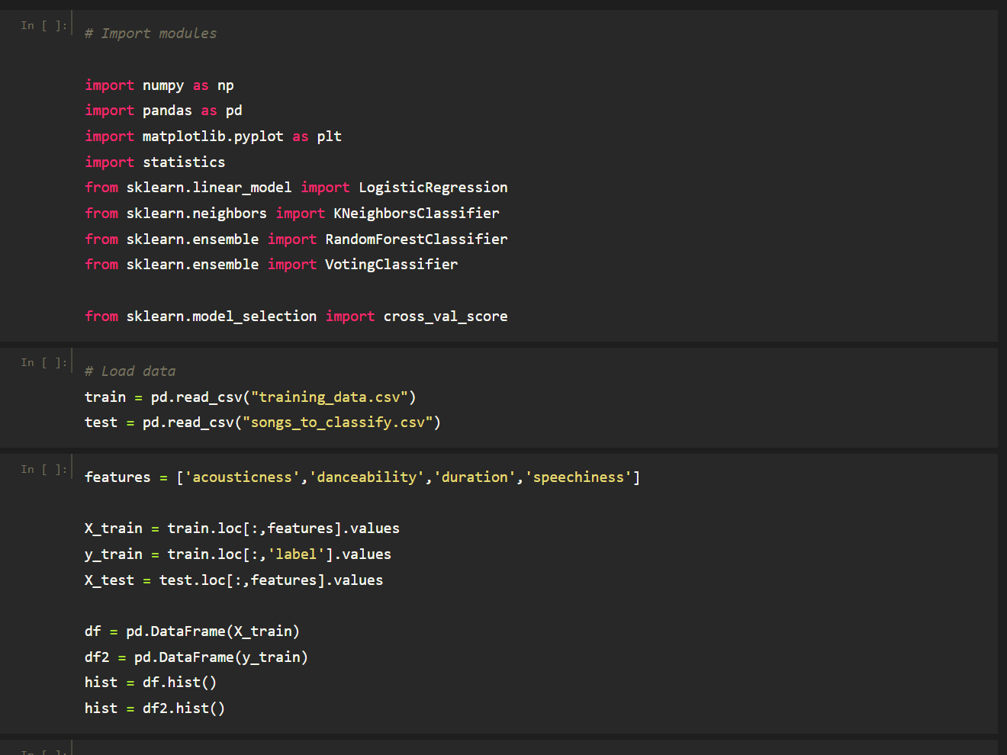
Code to reproduce(Updated)

Slide 11
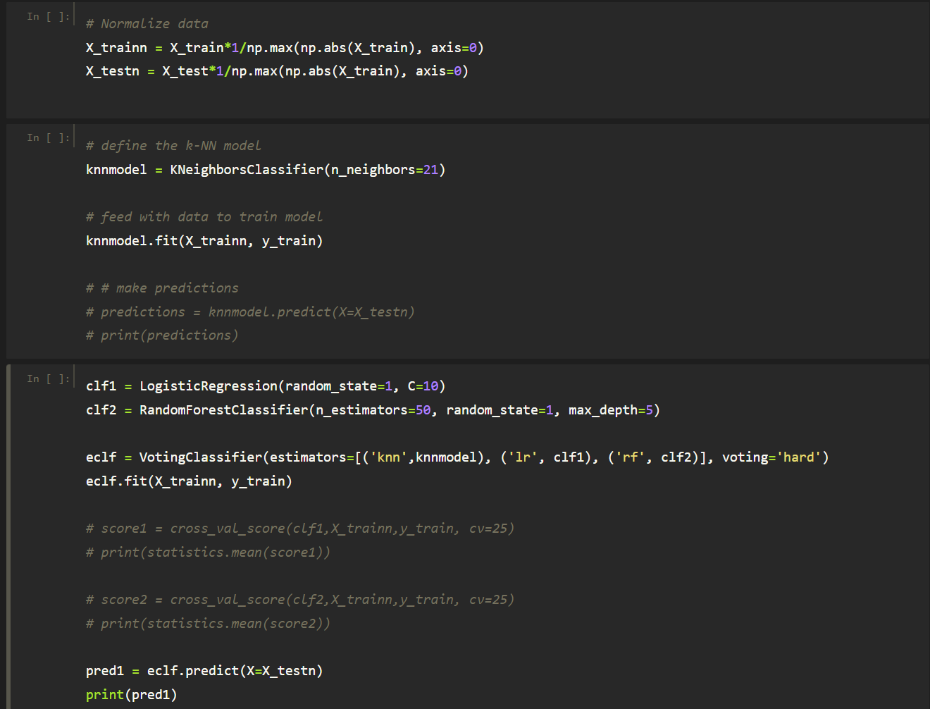
Code to reproduce(Updated)

